Slide 1

Montreal
User Group

Slide 2


+
Slack Group Name: Unity Slackers
MUUG Channel: #ugg-montreal
Signup URL: http://unityslackers.com/

Slide 3
Want to Do a Talk?
Always looking for new speakers
Art, Design, Development, or even Production
Both short and longer talks works
Any experience level
Contact me on @ByMayne or email ByronMayne@gmail.com

Slide 4
Creating the Usable
Creating Tools that people will really use
Byron Mayne

Slide 5
The Editor Basics
We will cover some of the most common tools you will need when creating your own tools.

Slide 6
Visual Editor Types
Inspectors
Used to inspect Objects in the scene when they are selected
Can edit multiple objects at once
Created inheriting from the Editor type.
Created automatically when you select an Object that matches the target.
Editor Window
Created by inheriting from EditorWindow type.
Opened normally with a MenuItemAttribute
Property Drawers
Used to make an editor for an attribute or a non-monobehaviour type.
Created by Serialized Properties whenever they find a matching target.

Slide 7
Asset Database
Everything that is in Unity is part of the Asset Database
Find assets
Filter by type
Create, move, rename, and delete
Callbacks built in to allow you to respond to events.

Slide 8
Serialized Properties
Abstract way of dealing with serialized data in Unity.
Supports multi editing and undo.
Similar to reflection
Can edit private values
Can’t edit none serialized fields.
One of the most powerful tools in your tool belt.

Slide 9
The Object Reference Problem
This is one problem that I have continue to solve on every project I work on.

Slide 10
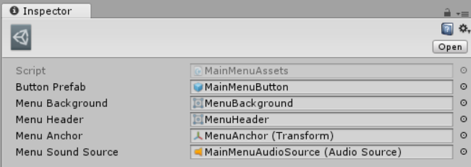
Object References
Pros
Users of Unity understand how to use them without explanation
Type safe
Asset Database features built in
Cons
When you load the root all references are loaded into memory too

Slide 11
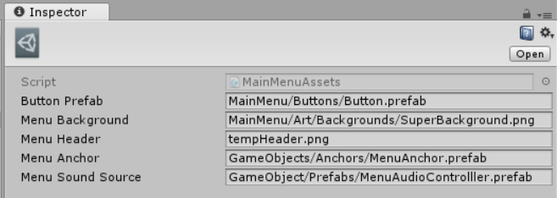
Resource Paths
Pros
No unused objects are loaded into memory
Cons
Easy to make a mistake or type
Moved or deleted assets will not be pointed out
Pain in the butt to type out the asset path

Slide 12

Copy Path Utility
Copy the Asset Path or Resource with a right click
Pros
User does not have to type the path
No chance for a typo

Slide 13

Copy Path Utility
Requires
Adding to a context menu
Getting the selected asset path
Copying the path to the clipboard

Slide 14

Dragging, makes everything better
Add Drag and Drop to our string field
Pros
Requires one less click

Slide 15
Breaking It Down
Add visual to the text area when the user drags an object over.

Slide 16
Breaking It Down
Add visual to the text area when the user drags an object over.

Slide 17
Breaking It Down
Add visual to the text area when the user drags an object over.
Handle the EventType.DragPerform event

Slide 18
Breaking It Down
Add visual to the text area when the user drags an object over.
Handle the EventType.DragPerform event
Capture object from DragAndDrop class.

Slide 19
Breaking It Down
Add visual to the text area when the user drags an object over.
Handle the EventType.DragPerform event
Capture object from DragAndDrop class.
Get first dropped object and set our property to the property

Slide 20

Lipstick on a Pig

Slide 21

Could you have your cake and eat it too?
Could we have an object reference in the inspector
Behind that object reference only serialize an asset path?

Slide 22
Tools Goals
Serialize as a single string path.
No extra data is serialized.
Work on any serialized string field.
Warn user is placed above invalid type.
Look like an behave like an object reference.
Should require no extra knowledge to use.

Slide 23
Breaking It Down
Create an object field with a local object instance

Slide 24
Breaking It Down
Create an object field with a local object instance
Create initialization flag and try to load instance

Slide 25
Breaking It Down
Create an object field with a local object instance
Create initialization flag and try to load instance
If instance changes get it’s asset path and assign it to our property

Slide 26
Breaking It Down
Create an object field with a local object instance
Create initialization flag and try to load instance
If instance changes get it’s asset path and assign it to our property
Create warning if the attribute is applied to the wrong type

Slide 27
Feedback Is Key
It’s best to try to let your users know when something goes wrong.
If input can be validated do it.
The example we just wrote is limited and has one tragic flaw.

Slide 28
Questions?
Twitter: @ByMayne
Email: ByronMayne@gmail.com

